Slide 1
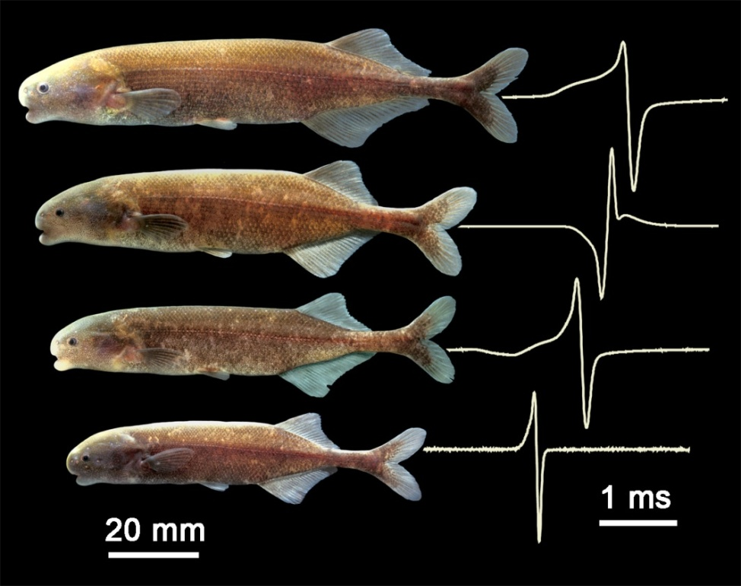
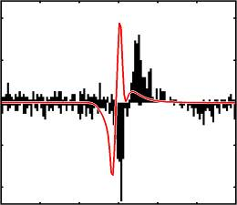
Electric fish as a model system
(in neuroscience teaching)
Carl D. Hopkins
Cornell University
June 21, 2013
Craw-FLY
June 2013
Notes:
Title slide,
I would like to thank Susan Perkins, Pedro Peloso, and John Flynn for arranging this opportunity to speak to you today.
I would also like to thank Melanie Stiassny, John Sparks, Scott Schafer and the rest of the staff in the Department of Ichthyology for providing space and time the kindness they have shown to me on my sabbatical from Cornell here at the AMNH.
My lecture is entitled TAXA, TREES, TIMING and TONEs.
In this lecture I will discuss “Evolutionary design principles for electrical communication among fish.
I will review the various taxa of Mormyroidei, the electric fishes from Africa
I will then talk about Trees and Tones – how recent molecular based phylogenetic trees have revolutionized our understanding of relationships of the various taxa in a very confused group, and how it results in understanding of the signals that they produce and even give insights into how other groups might undergo rapid, adaptive radiations
Finally I will speak of timing and signal reception – thinking back to the design principles, I will focus on the temporal properties of signals, how they are encoded by the nervous system, and how timing affects the interpretation of signals by receivers.

Slide 2
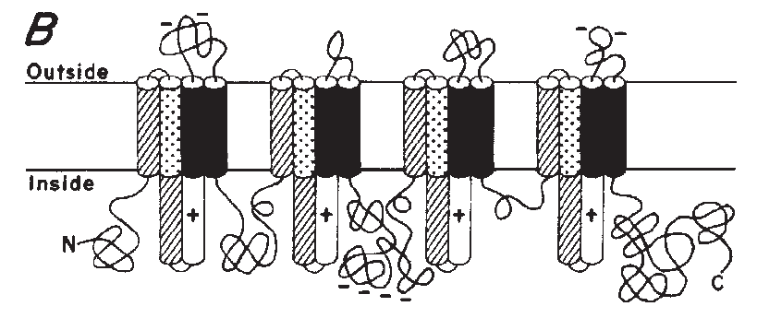
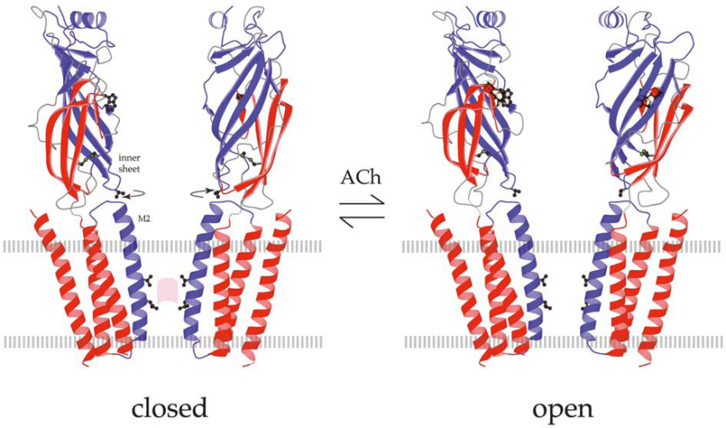
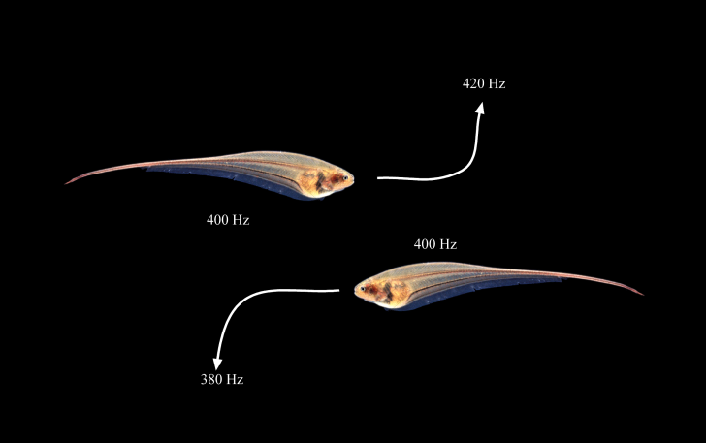
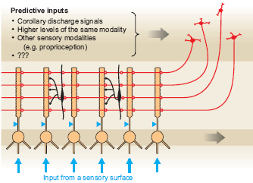
S. Numa (1984)
Electrophorus
Miyazawa, Fujiyoshi, and Unwin, N. (2003)
Torpedo
Heiligenberg, 1990
Eigenmannia
Bell, 2008
Gnathonemus
Notes:
I don’t need to convince anyone in this room of the importance of comparative biology for finding novel solutions to basic and applied problems in the study of biology and medicine.
In my lecture, I will be talking about specialized electric fishes
Before I begin, however, let me illustrate some of the remarkable discoveries made to the field of Neuroscience through the use of electric fish.
There are many reasons to study unusual animal species when attempting to understand biological problem. As the Danish Physiologist and Nobel laureate, August Krogh, pointed out in 1929, “For such a large number of problems there will be some animal of choice, or a few such animals, on which it can be most conveniently studied." Neuroethologists often refer to this as Krogh’s principle. It is well illustrated here for several important discoveries that utilized electric fish as study species.
Numa’s first cloning of the sodium channel, and determination of its primary structure, was done in the electric eel, where there is an abundance of electric organ, packed with sodium channels. The structure of the Acetylcholine recepotor was first done using electron microscopy in the Torpedo Ray, which has abundant electric organ packed with Acetylcholine recepors, These ion channels are the primary gated current in the electric discharge of Torpedo.
Then one of the first complex neural circuits to be deceiphered at the cellular level from sensory receptor to motor output was the Jamming Avoidance Response in Eigenmannia virescens, was completed in studies by Walter Heiligenberg and colleagues. The Jamming avoidance response is seen when two electric fish with similar sinusoidal discharge frequencies meet, and one fish goes up in frequency and one goes down to avoid jamming of their electrolocation abilities.
Finally a most remarkable case of cancellation of predicted sensory inputs of self-produced sensory reafference was worked out in the electric fish Gnathonemus petersii by Curtis Bell and colleagues, including Nate Sawtell here at Columbia University in the electrosensory lateral line lobe. This cerebellum like strucutre receives predictive signals from corollary discharges forom the electromotor system, from higher brain areas in the same sensory modalities, or higher brain areas in other sensory modalities such as proprioception. By a novel and remarkable case of antihebbian plasticity, predicted sensory responses are systematically removed from the incoming sensory input.
In my lecture, I will make the case that these electric fishes may serve not only as a model system for molecular strucutres or neural circuits, but for the very process of evolution and speciation itself. I will try to show that the electric fish provide opportunities to study many fundamental evolutionary processes leading to speciation and underlying adaptive radiations.

Slide 3
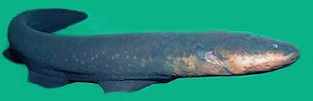
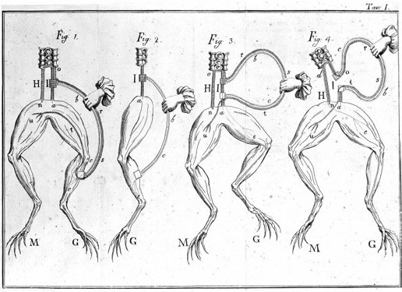
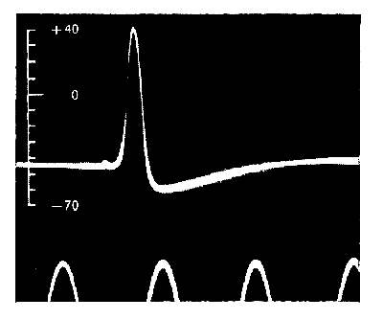
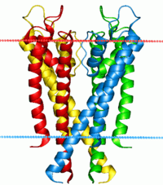
BIOELECTROGENESIS
Gymnotus electricus Linnaeus, 1766
Linnaeus 1766
Galvani 1791
Hodgkin & Huxley 1939
MacKinnon 1998
Notes:
The 2003 Nobel Prize in Chemistry was awarded to Roderick MacKinnon at the Rockefeller University for determining the structure of the Potassium Channel in cell membranes of nearly all living cells. In many ways, this structure was the culmination of more than 200 years of effort to understand the physical basis for animal electricity, well known from the famed electric eel appropriately named by Linnaeus, explored by Luigi Galvani, in the squid axon by Hodgkin and Huxley.
But it is the electric eel, and other strongly electric fish that inspires the imagination of most people.

Slide 4
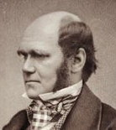
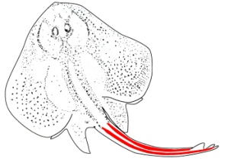
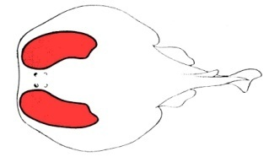
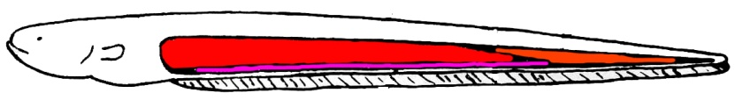
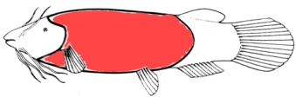
1859
“The electric organs of fishes offer another case of special difficulty; it is impossible to conceive by what steps these wondrous organs have been produced…”
Rajiformes (Electric Skates)
Torpediniformes (Electric Rays)
Gymnotiformes
Siluriformes (Catfishes)
Notes:
Interest in bio electrogenesis dates back to the discoveries of animal electricity by Luigi Galvani and fascination with the strongly electric fish brought back to European salons from South America, Africa, and the medeterranian. The anatomy of the electric eel apparently inspired Volta’s voltaic pile
Darwin was puzzled by the strong electric organs of fishes which offered even more serious difficulty for his theory of natural selection.
It may have been a case of special difficulty, but evolutionary theory survived it, although Darwin’s puzzle wasn’t solved for nearly 100 years.

Slide 5
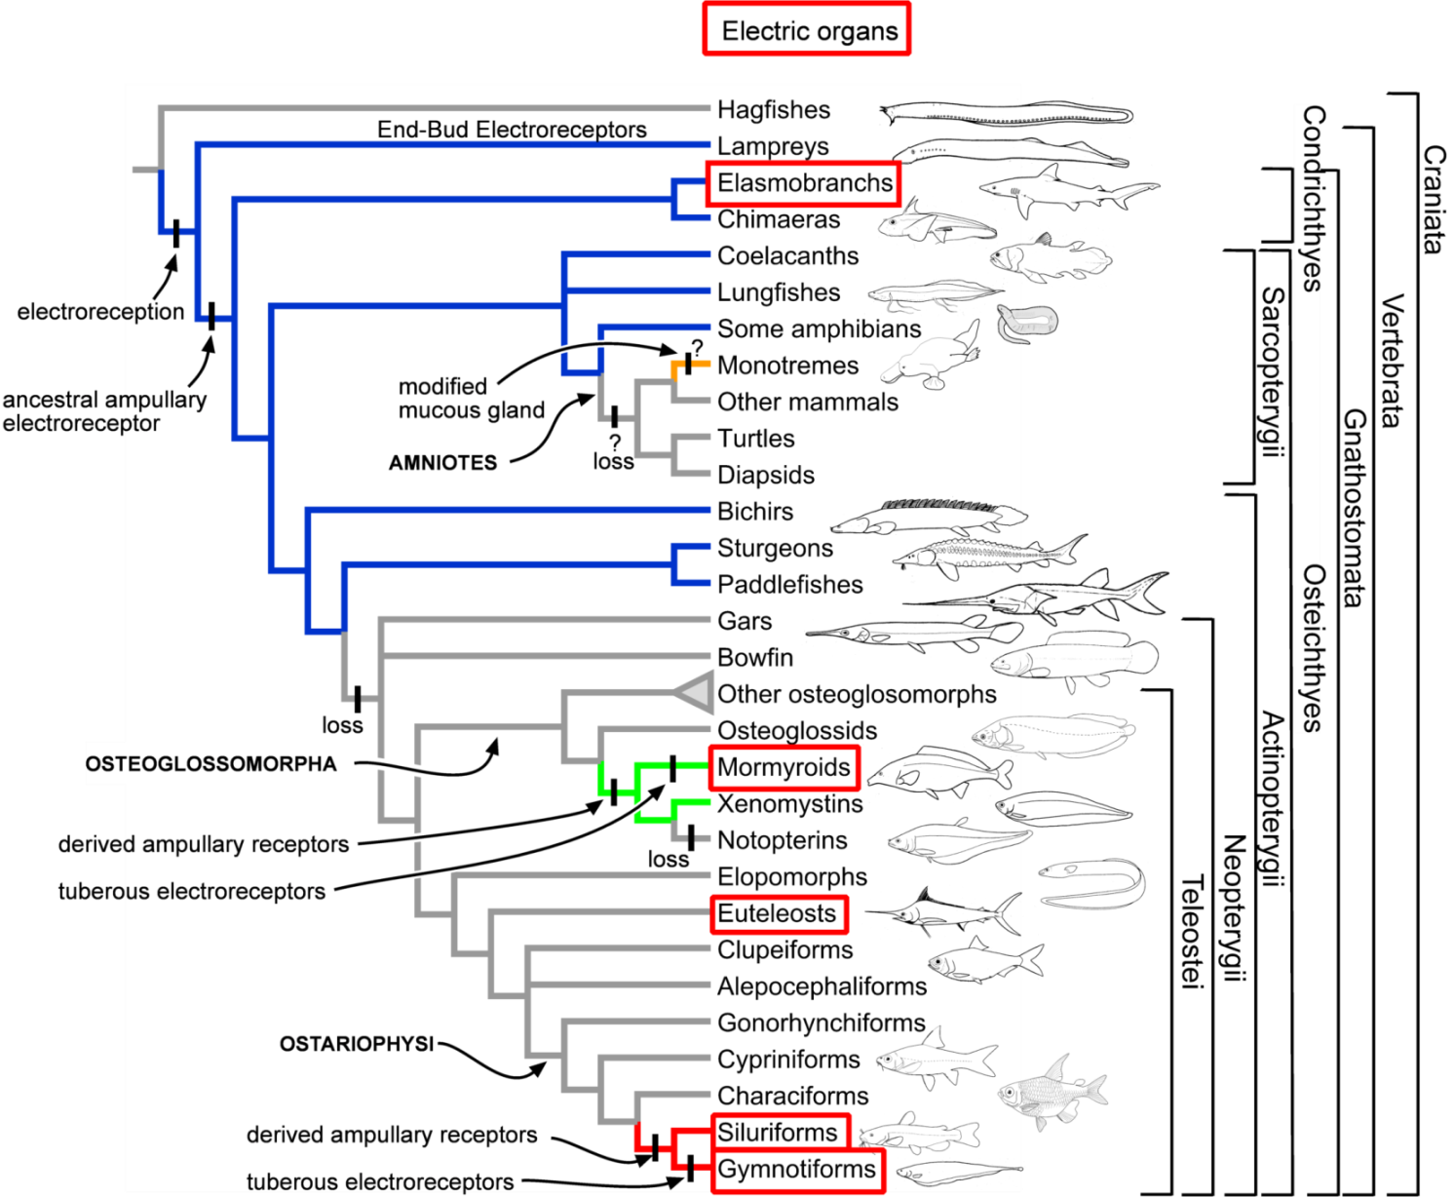
Evolution of Electroreception
electroreception
In Lavoué, Miya, Arnegard, Sullivan, Hopkins, Nishida (submitted) Comparable Ages for the Independent Origins of Electrogenesis in African and South American Weakly Electric Fishes PLOS One

Slide 6
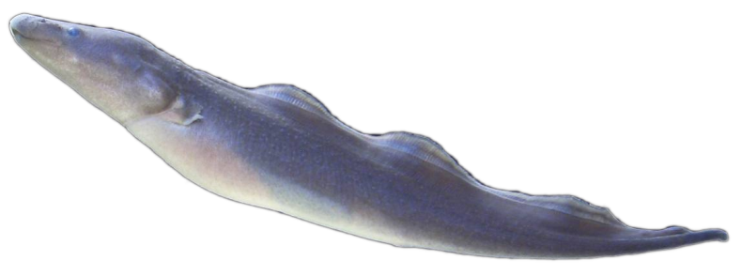
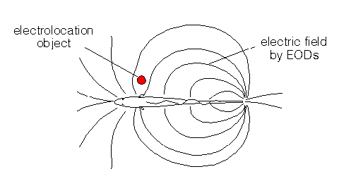
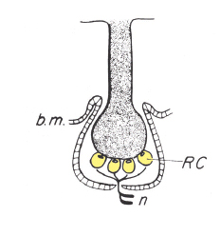

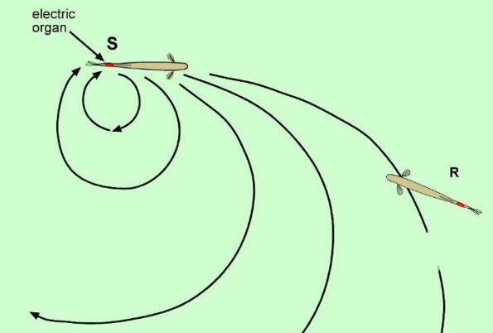
Functions of Electroreception
Weak electrogenesis, Lissmann 1951
Gymnarchus niloticus
Active electrolocation, Lissmann and Machin 1958
Passive electrolocation, Kalmijn, 1971
Electroreceptor, 1961
Electrical communication, 1965-72
Möhres, Moller, Kramer, Hopkins, Black-Cleworth
Bullock
Notes:
It was the discovery of weak electrogenesis in Gymnarchus in 1951 by Hans Lissmann of Cambridge University that led to the discovery of electroreception
And the subsequent discovery of Active electrolocation of objects in 1958
Of passive electrolocation in animals with just electroreceptors
And of electrical communication,
It was clear that mulitiple functions for weak electric organs served as the intermediate step in the evolutin of strong dicharges that puzzled Darwin.
Functional electroreceptors were discovered soon afterwards.

Slide 7
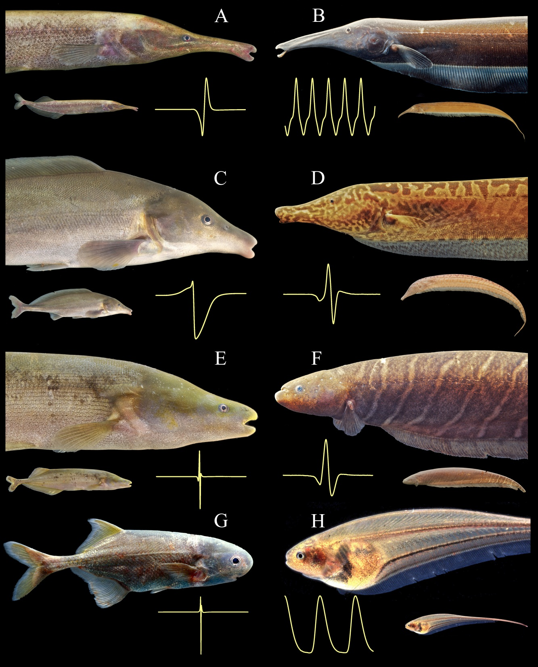
MORMYRIDAE
GYMNOTIFORMES
Lavoue et al 2012

Slide 8
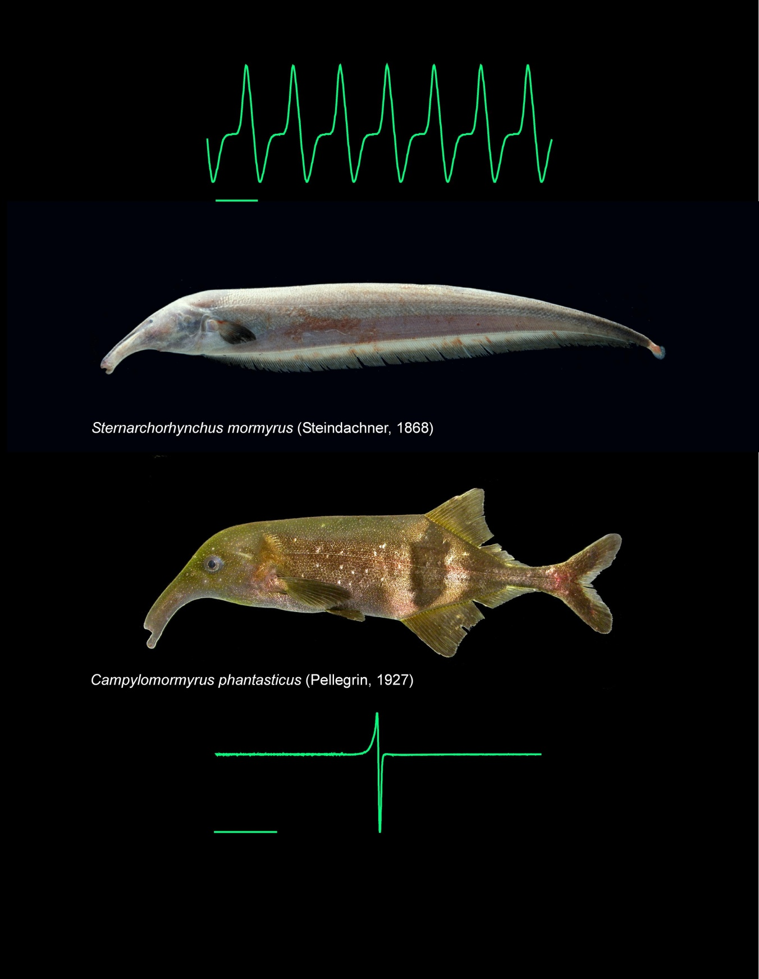
Gymnotiformes
Mormyriformes
© C. D. Hopkins

Slide 9
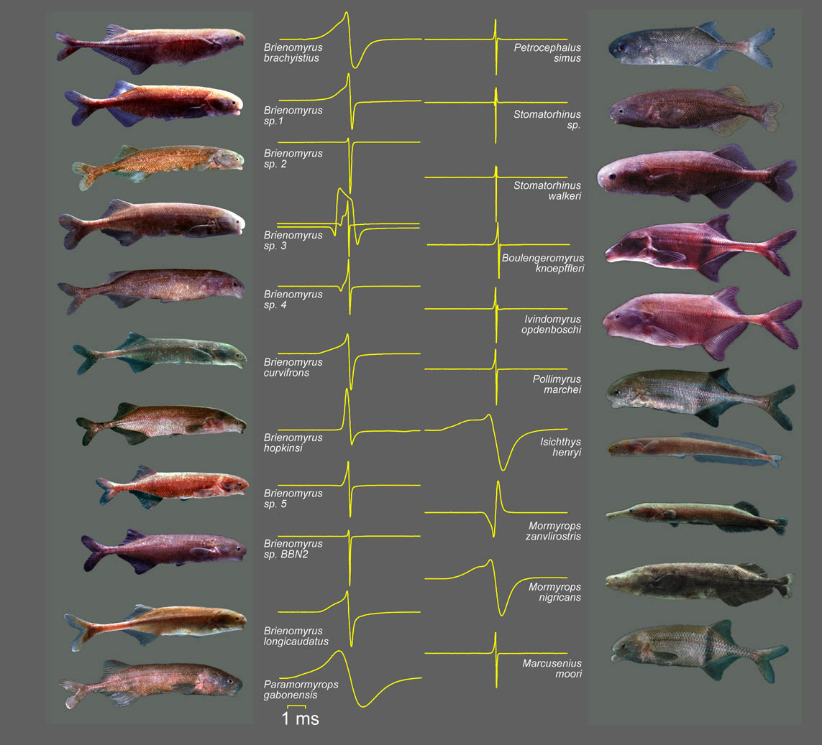
Mormyridae, Ivindo River Gabon
Notes:
Today I will focus on diversity in electrogenesis, as represented by its expression in the electric organ discharge signals used by weakly electric fish for communication and electrolocation.
In my talk I will point to a number of evolutionary milestones – innovations in either the generation or the reception of signals that coincided, and may have played a key role in promoting the biodiversity of two major groups of electric fishes evolving independently.

Slide 10
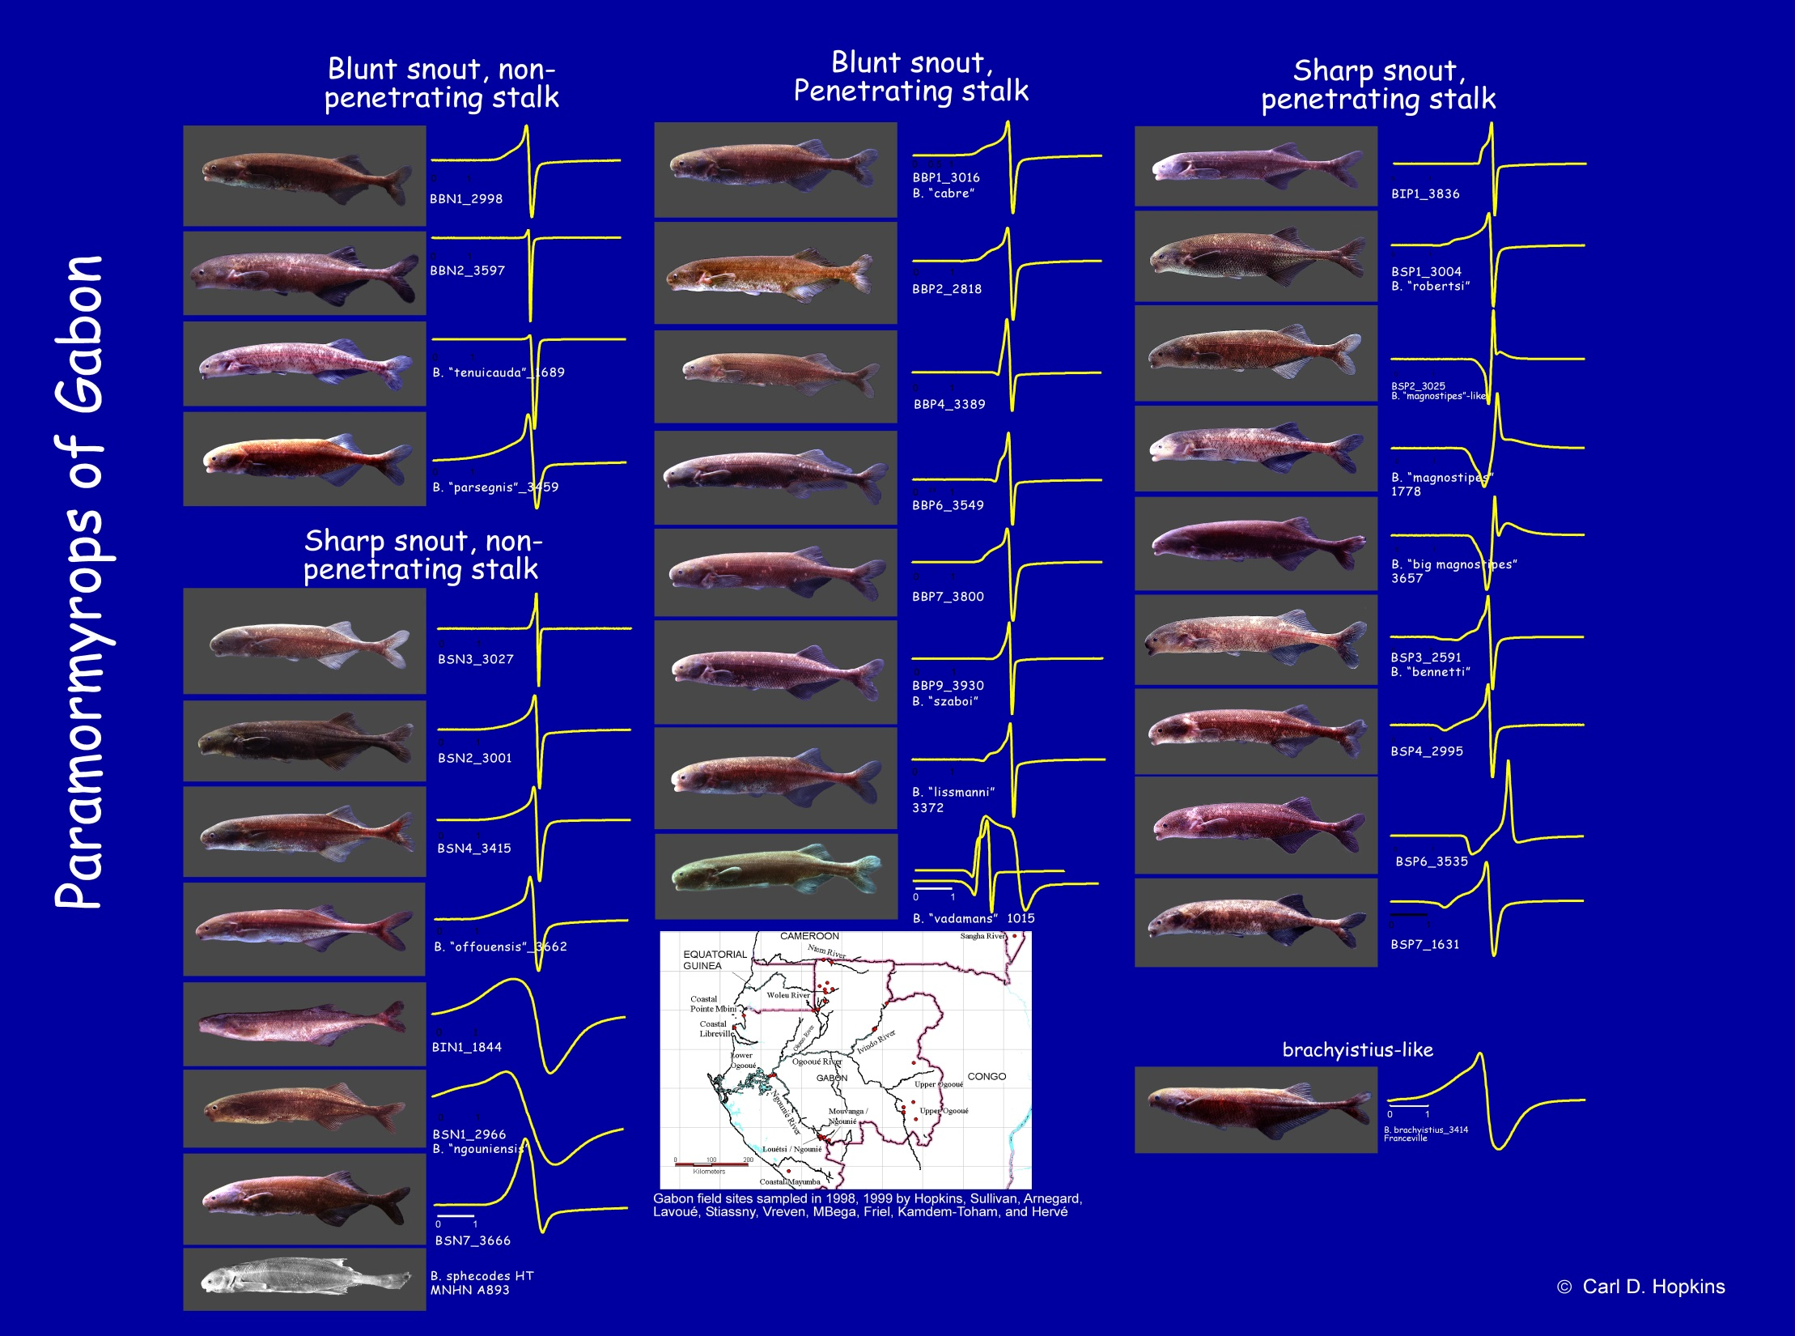
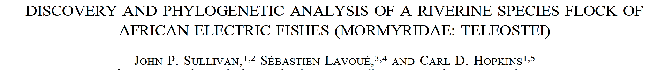
Sullivan, J. P., Lavoué, S. & Hopkins, C.D. (2002) Evolution 56(3):597
Notes:
Many students have asked me how I got started in biology and what has directed me on my career path.
I have to admit that what inspires me has been the opportunity to make discoveries about the natural world.
I have never been a strong theoretical scientist, nor one who does clever experiments. Instead I have been willing to expore the world and to look in new places or at problems in a new way, and I have made descriptions of what I have seen.
I think one of the most interesting things I have observed and helped discover was an entire flock of
In 2002 after more than 25 years, John Sullivan, Sebastien Lavoue and I published the first description of a species flock of electric fishes from Gabon.
We used to call them the Gabon – clade of Brienomyrus now they belong to the genus Paramormyrops.
It consists of 38 putative species, or OTUs
They form A monophyletic group. It is endemic to Gabon, Cameroon, and Congo.
They are distinguised by their diverse electric organ discharges.

Slide 11
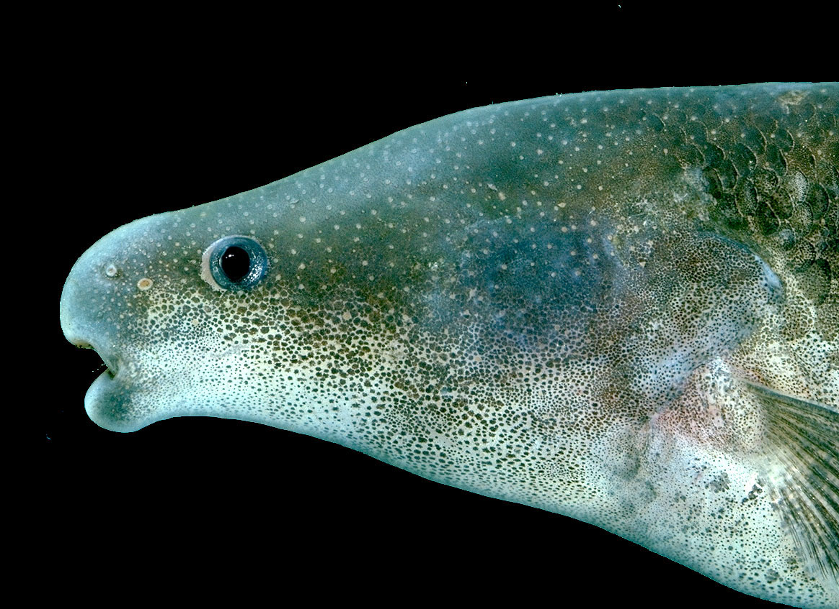
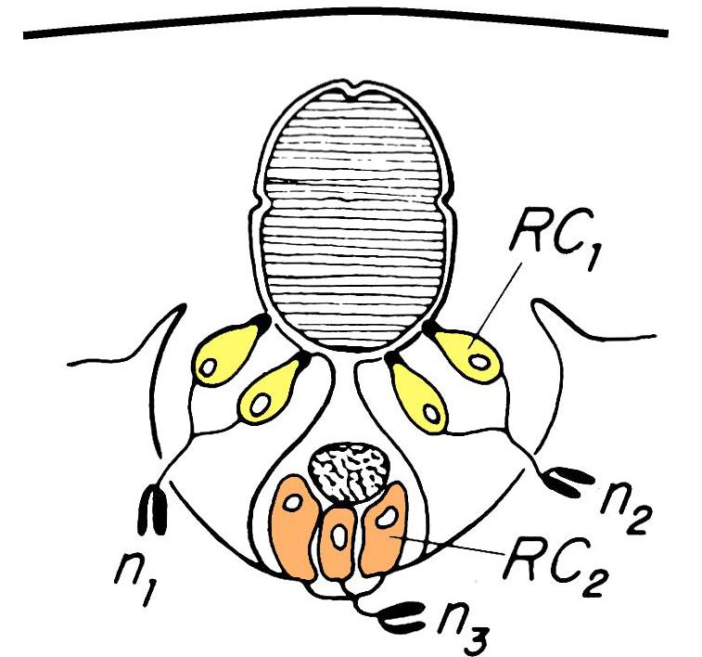
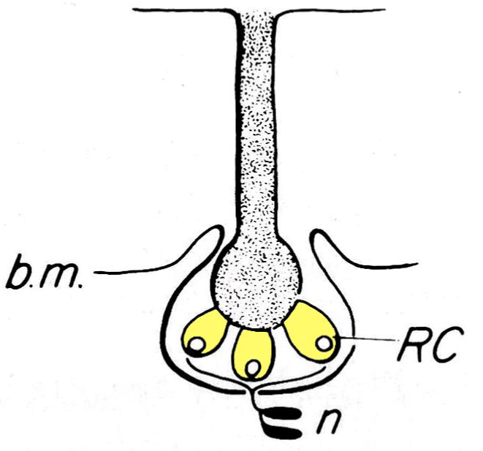
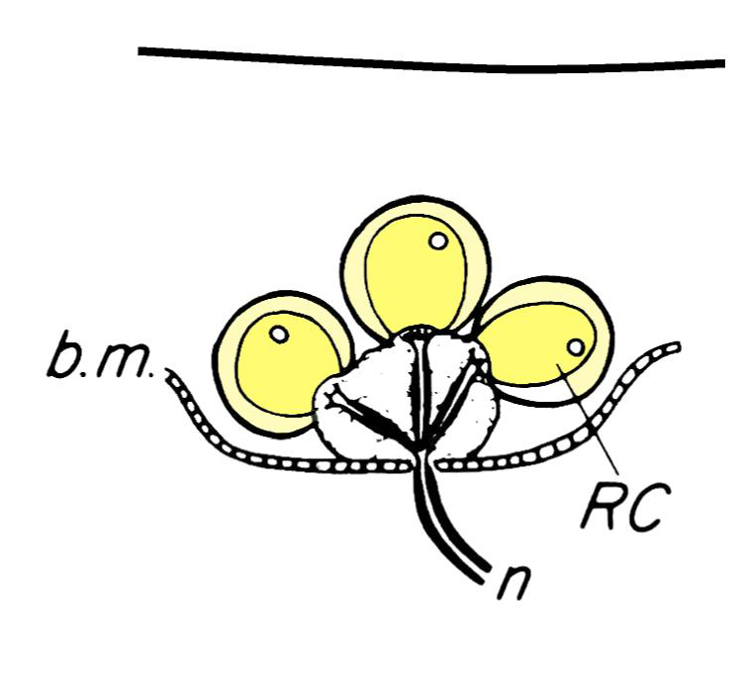
Ampullary
Mormyromast
Knollenorgan

Slide 12
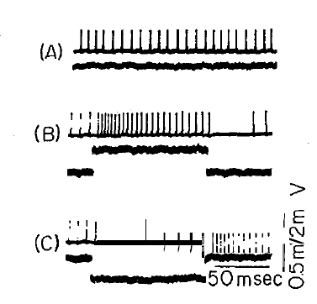
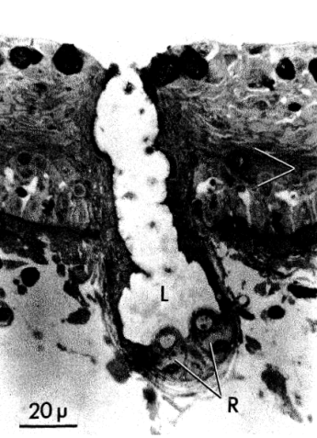
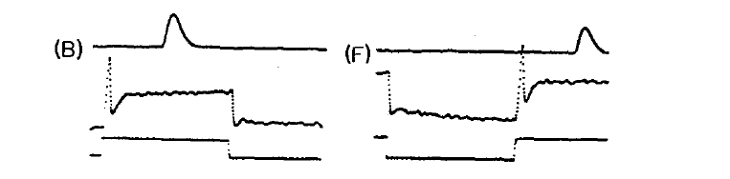
Ampullary vs. Tuberous Electroreceptors
Ampullary
(tonic)
canal
DC
tonic firing
Tuberous
(phasic)
no canal
A. C.
time coding
amplitude coding

Slide 13
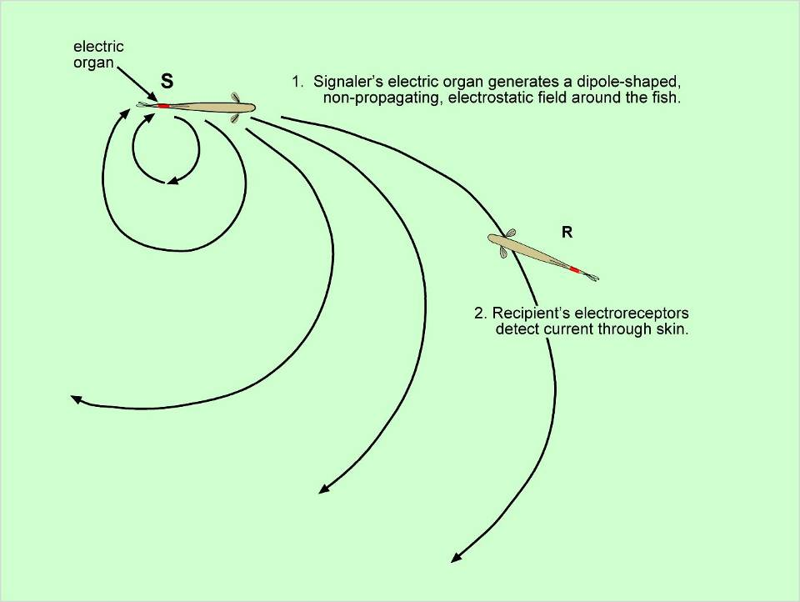
ELECTRORECEPTION AND COMMUNICATION

Slide 14
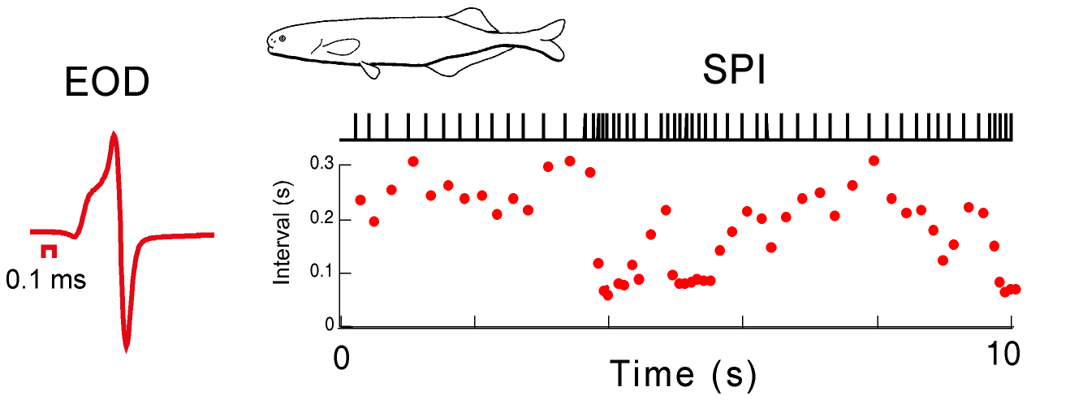
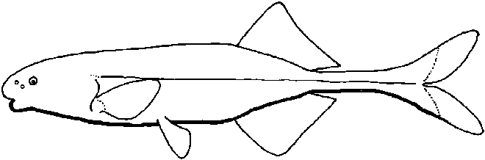
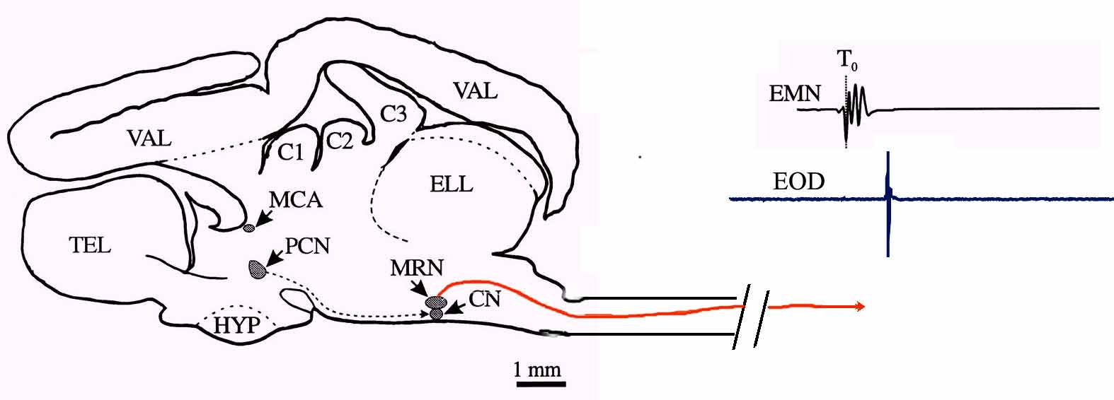
Fixed and Variable Signals
Carlson and Hopkins (2004)

Slide 15
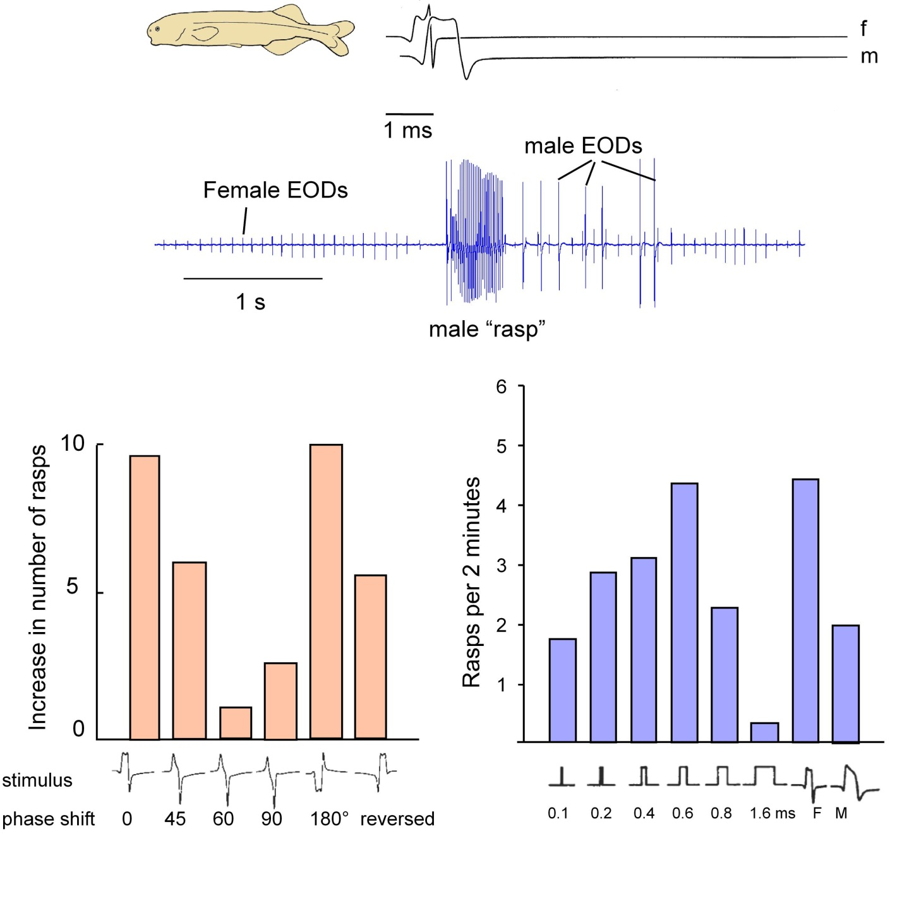
Adapted from Hopkins and Bass, 1981 (Science)

Slide 16
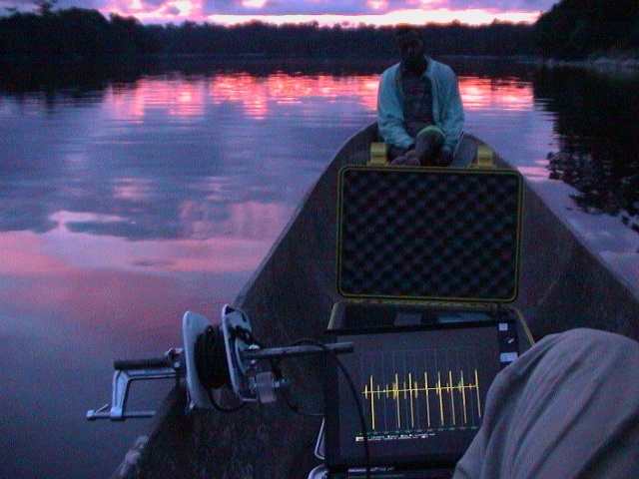

Slide 17
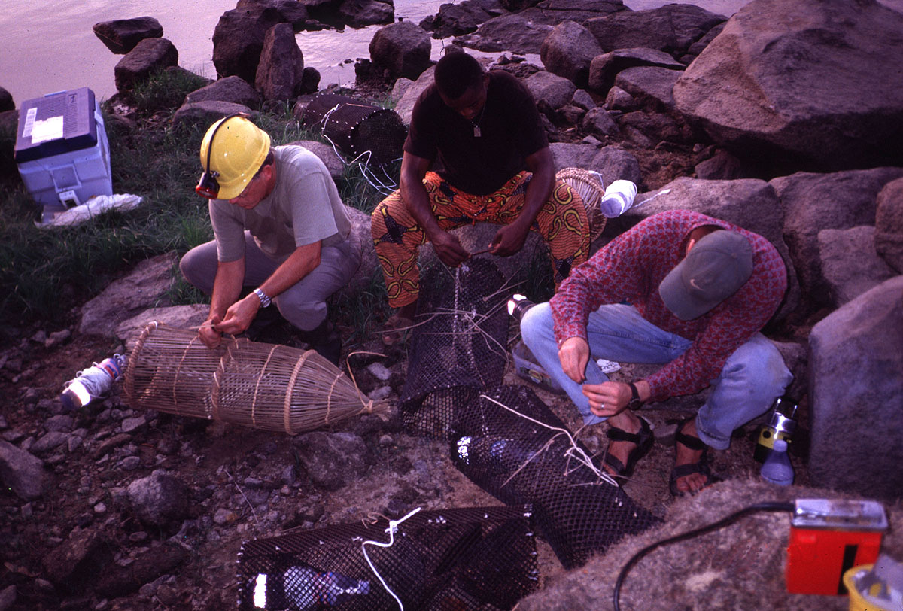
baiting fish traps

Slide 18
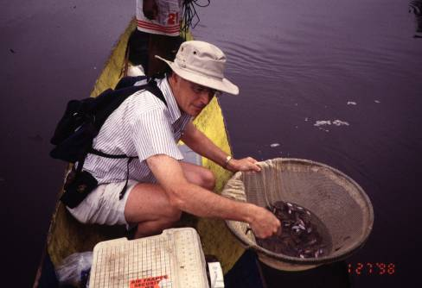
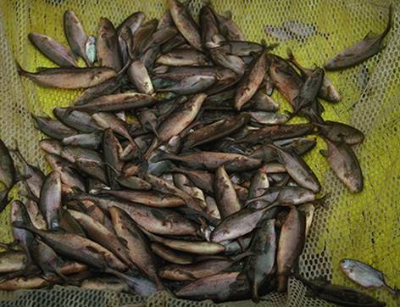

Slide 19
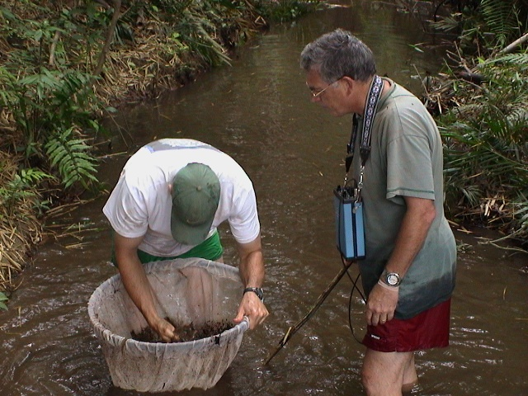

Slide 20
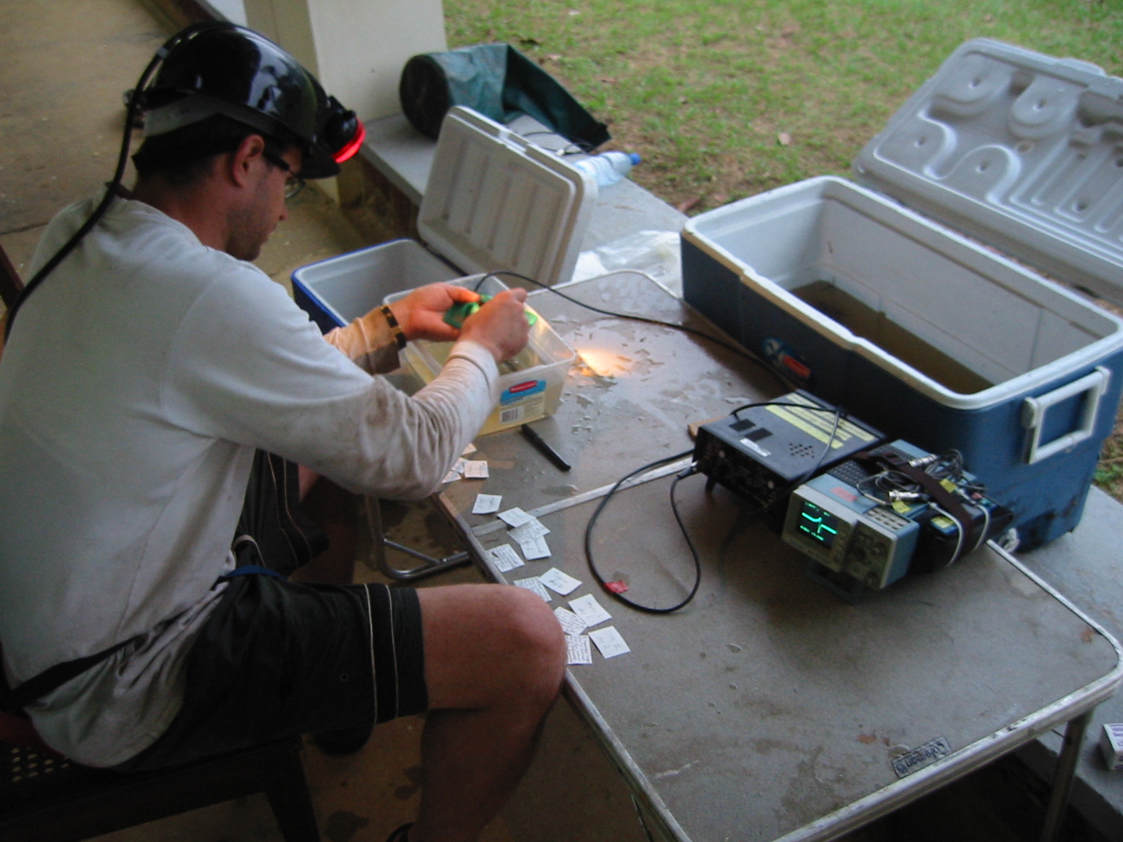
Matt Arnegard

Slide 21
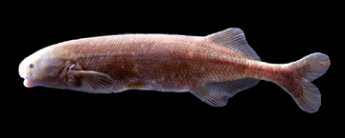
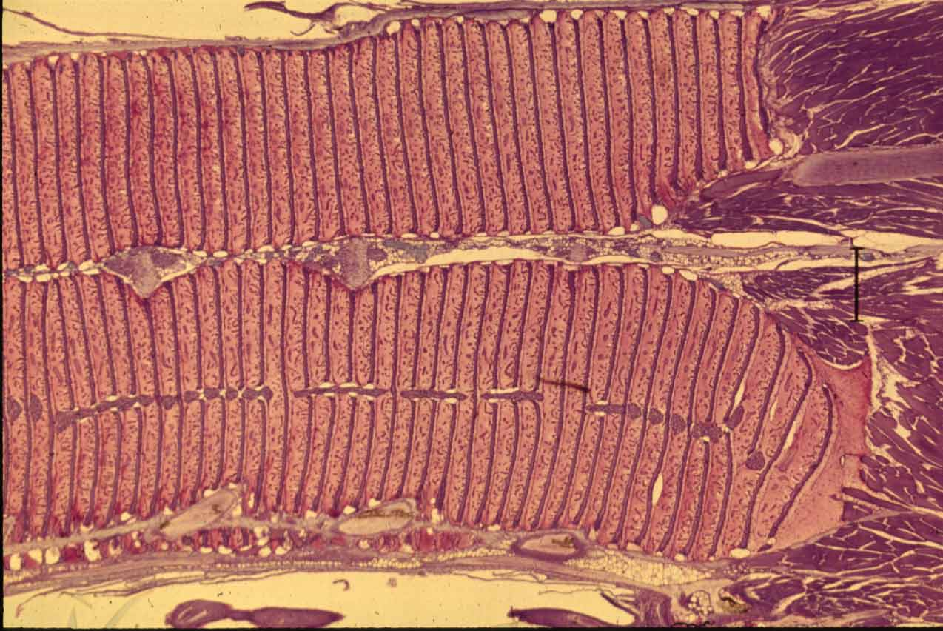
Electric Organs - Electrocytes
Paramormyrops kingsleyae

Slide 22
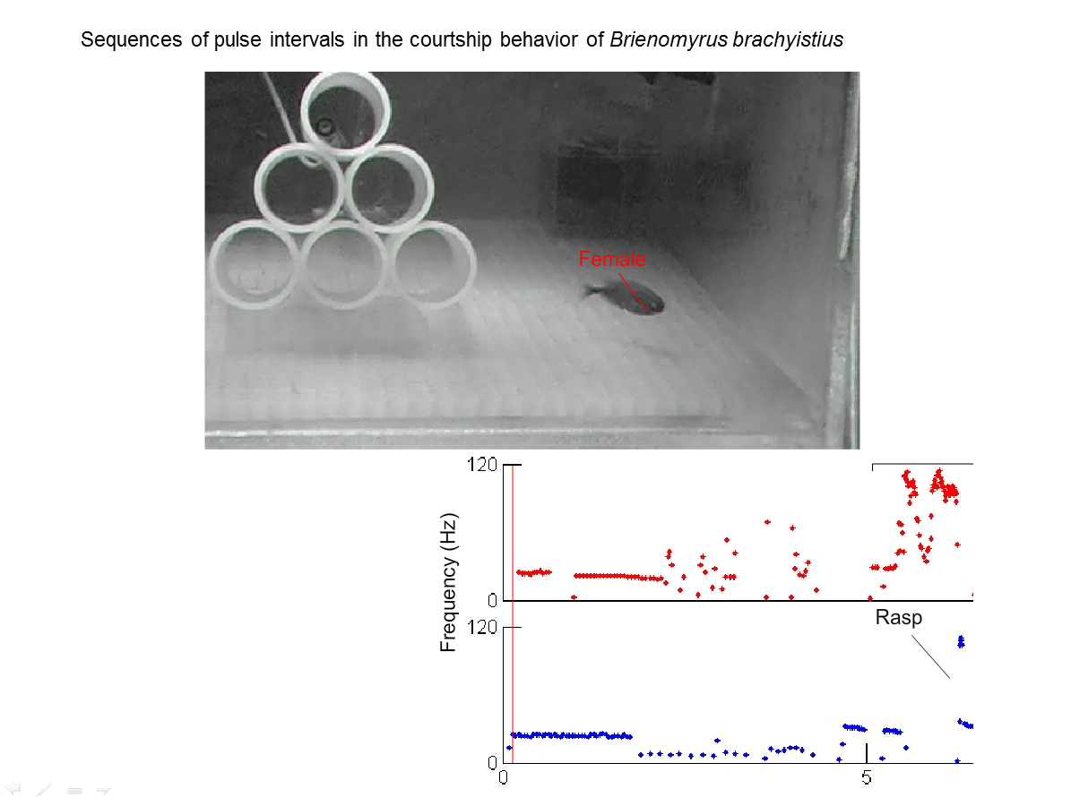
Notes:
What you are going to see now is a video of courtship of a mormyrid, Brienomyrus brachyistius filmed with infrared illumination in complete darkness. The recorded signals, which we hear have been separated by computer so that we can see the instantaneous freuqnecy of the male and the female. The reconstructed pulse trains are then playedthrough separate channels for the audio track of this recording. We see typical sequences, creaks, rasps, and LRADs (long repeated acceleration and deceleration) that make up stereotyped courtship displays.

Slide 23

Sequences of pulse intervals in the courtship behavior of Brienomyrus brachyistius
Notes:
What you are going to see now is a video of courtship of a mormyrid, Brienomyrus brachyistius filmed with infrared illumination in complete darkness. The recorded signals, which we hear have been separated male from female, and are played through separate channels. The instantaneous pulse frequency plots below show fragments of the courtship displays.

Slide 24
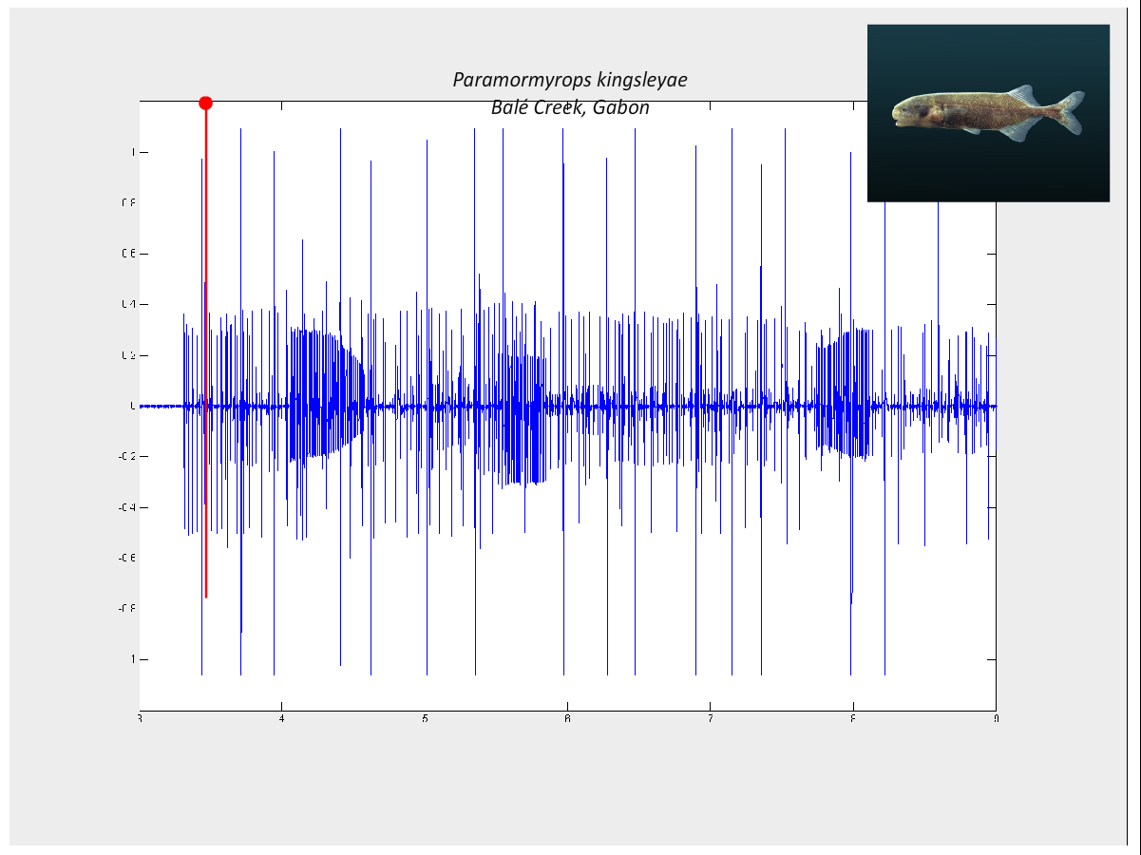

Slide 26
Adapted from Hopkins and Bass, 1981 (Science)

Slide 27
Electric Organs - Electrocytes

Slide 28
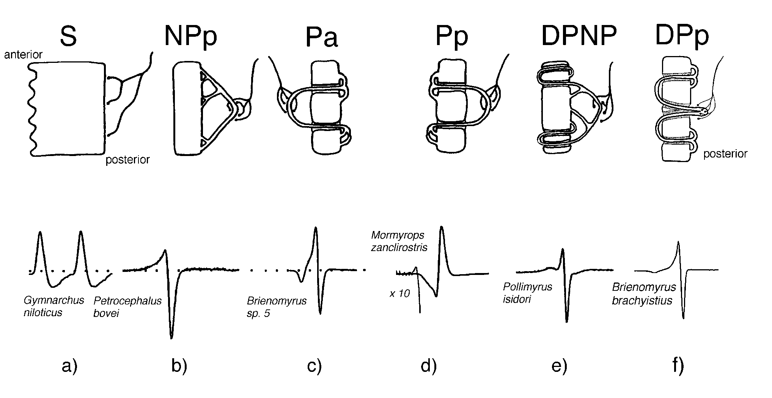
Stalkless
Non-penetrating
stalk
Penetrating stalk

Slide 29
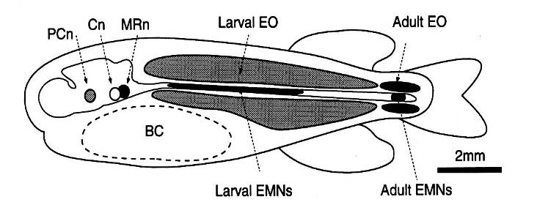
From Westby & Kirschbaum, 1978
Larval
Mormyridae

Slide 30
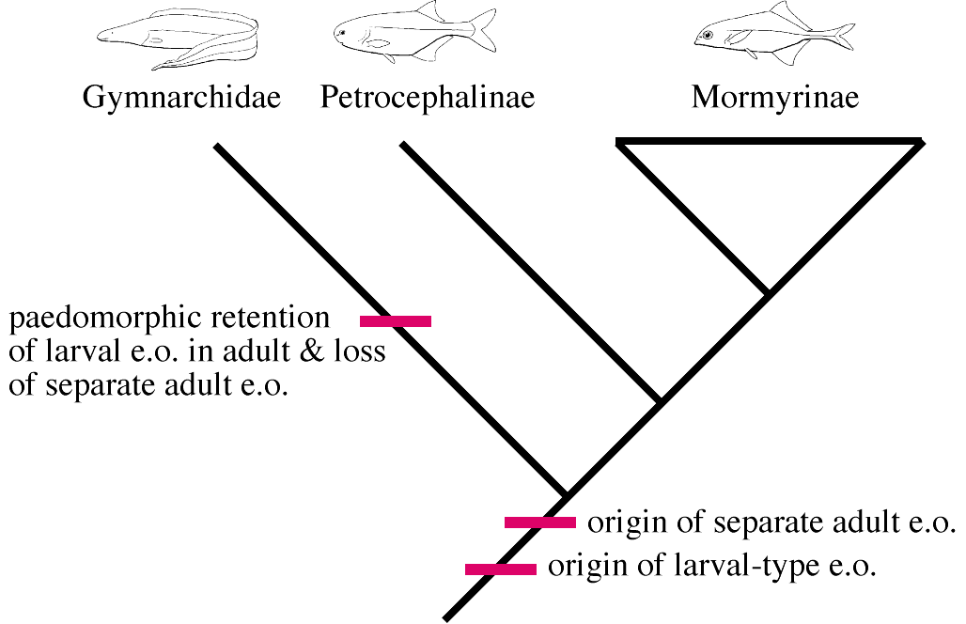

Slide 31


Slide 32

penetrating stalks (P)
non-penetrating stalks
(N)

Slide 33


Slide 34


Slide 35



Slide 37

Notes:
This talk is about a recently discovered species flock of mormyrid electric fish from west central Africa belonging to the genus Paramormyrops, formerly known as Brienomyrus.
Illustrated here are 11 species and their associated Electric Organ Discharge waveforms, plotted as oscilloscope sweeps on the same time scale with head positivity upward.
These 11 species live sympatrically in the Ivindo River of Gabon in West Central Africa.
Five have been described but six additional species were discovered by the Hopkins lab after being diagnosed from their signature EOD waveforms. The working temporary names are shown in quotes.
Paramormyrops are endemic to Gabon, Equatorial Guinea, Cameroon, and parts of the Congo, the center of diversity is Gabon; We believe there are more than 20 species in the genus of which 6 are described.

Slide 38

Notes:
NUMBER OF PEAKS IN THE EOD. The number of peaks in the EOD are controlled by the anatomic structure of the electric organ. The fist on the left all have electrocytes with NON PENETRATING Stalked electrocytes and the waveforms all have two peaks. Those on the right have penetrating stalked electrocytes and the waveforms have three phases.
FINE STRUCTURE OF WAVEFORM. THE EODS also differ in details of the fine structure of the waveform. Thus, P. curvifrons has a relatively smooth rising phase to the EOD while P. longicaudatus has an inflection point on the rising phase. Inflection points are also present in P. kingsleyae and in P. vadamans

Slide 39

Notes:
In this talk we will explore geographic variation in the EOD waveform of a single species, Paramormyrops kingsleyae, which has a widespread distribution in West Central Africa.

Slide 40
Cyt
b
IN1
1844(M
id
Ogo
ou
é
)
AFLP
IN1
1844(M
id
Ogo
ou
é
)
97
SN4
3396/3465(U
pper
Ogo
ou
é
)
SN2
2595(Lou
é
tsi
)
100
B.cf.curvifrons
4149(Okan
o
)
SN2
2969(Lou
é
tsi
)
65
B.longicaudatus
2289(Ivin
do
)
SN4
3465(U
pper
Ogo
ou
é
)
B.curvifrons
2050(Ivin
do
)
B.cf.curvifrons
4149(Okan
o
)
NGO
2710(Lou
é
tsi
)
B.curvifrons
2050(Ivin
do
)
SN3
2606(Mouv
anga
)
NGO
2710(Lou
é
tsi
)
59
87
CAB
2116(Ivin
do
)
SN3
2606(Mouv
anga
)
69
SN3
2619(Mouv
anga
)
SN7
3666(U
pper
Ogo
ou
é
)
OKA
4150(Okan
o
)
100
BP6
3547(U
pper
Ogo
ou
é
)
BN2
3542(U
pper
Ogo
ou
é
)
BN2
3542(U
pper
Ogo
ou
é
)
SN4
3396(U
pper
Ogo
ou
é
)
PAR
3461(U
pper
Ogo
ou
é
)
SN7
3666(U
pper
Ogo
ou
é
)
100
OFF
2643(Lou
é
tsi
)
OFF
2643(Lou
é
tsi
)
95
OFF
3394(U
pper
Ogo
ou
é
)
B.longicaudatus
2289(Ivin
do
)
92
LIB
2427(Cap
E
sterias
)
OFF
3394(U
pper
Ogo
ou
é
)
BX1
4018(Co
cob
e
ach
)
LIB
2427(Cap
E
sterias
)
BN1
2718(Lou
é
tsi
)
BX1
4018(Co
cob
e
ach
)
99
BN1
2681(Biro
undo
)
CAB
2116(Ivin
do
)
SN2
2595/2969(Lou
é
tsi
)
CAB
3848(Ntem)
BP1
3358(Mayu
mba
)
BP1
3771(Wole
u
)
99
BP1
2704(Mouv
anga
)
CAB
4253(Okan
o
)
SN3
2619(Mouv
anga
)
BN1
2718(Lou
é
tsi
)
81
87
98
SP4
3026(Mouv
anga
)
BN1
2681(Biro
undou
)
SP2
2542/2638(Mouv
anga
)
BP1
3358(Mayu
mba
)
SP4
2995(Biro
undo
)
BP1
2704(Mouv
anga
)
SP2
2672/3203(Biro
undo
)
BP6
3547(U
pper
Ogo
ou
é
)
100
SP4
2671(Biro
undo
)
PAR
3461(U
pper
Ogo
ou
é
)
95
SP4
2673(Biro
undo
)
SP4
3026(Mouv
anga
)
84
SP8
3657(U
pper
Ogo
ou
é
)
SP2
2638(Mouv
anga
)
SP6
3658(U
pper
Ogo
ou
é
)
SP2
2542(Mouv
anga
)
MAG
3945(Ntem)
SP4
2995(Bir
oundou
)
SP2
3203(Biro
oundo
)
MAG
3999(Ntem)
SP2
2672(Bir
oundo
)
SP7
3966(Ntem)
SP4
2671(Biro
undo
)
77
64
MAG
4250(Okan
o
)
SP4
2673(Biro
undo
)
94
SP9
4164(Okan
o
)
MAG
3945(Ntem)
100
OKA
4150(Okan
o
)
MAG
4250(Okan
o
)
CAB
4253(Okan
o
)
SP9
4164(Okan
o
)
89
CAB
3848(Ntem)
SP8
3657(U
pper
Ogo
ou
é
)
94
MAG
2168(Ivin
do
)
SP6
3658(U
pper
Ogo
ou
é
)
MAG
2297(Ivin
do
)
MAG
3999(Ntem)
71
TEN
2011(Ivin
do
)
SP7
3966(Ntem)
TEN
2191(Ivin
do
)
MAG
2168(Ivin
do
)
66
TEN
3850(Ntem)
MAG
2297(Ivin
do
)
P.gabonensis
2048(Ivin
do
)
TEN
2011(Ivin
do
)
P.gabonensis
3980(Ntem)
TEN
2191(Ivin
do
)
P.gabonensis
4185(Wole
u
)
TEN
3850(Ntem)
87
SN8
1611(Ntem)
P.gabonensis
2048(Ivin
do
)
SN8
4210(Ntem)
P.gabonensis
3980(Ntem)
B.hopkinsi
2285(Ivin
do
)
P.gabonensis
4185(Wole
u
)
BP1
3771(Wole
u
)
SN8
1611(Ntem)
BON
2659+3(Lou
é
tsi
)
SN8
4210(Ntem)
85
SZA
3839(Ntem)
B.hopkinsi
2285(Ivin
do
)
100
SZA
2008(Ivin
do
)
BON
2659(Lou
é
tsi
)
86
LIS
3366(U
pper
Ogo
ou
é
)
SZA
3839(Ntem)
SZA
2008(Ivin
do
)
100
VAD
2425(Ivin
do
)
LIS
3366(U
pper
Ogo
ou
é
)
VAD
3814(Wole
u
)
VAD
2425(Ivin
do
)
Marcusenius ntemenis
2186(Ivin
do
)
VAD
3814(Wole
u
)
Pollimyrus marchei
03-0425
(Mayu
mba
)
Marcusenius ntemesnis
2186(Ivin
do
)
Pollimyrus marchei
03-0425
(Mayu
mba
)

Slide 41
LIB
2427(Cap
E
sterias
)
BX1
4018(Co
cob
e
ach
)
“cabrae complex”
CAB
2116(Ivin
do
)
CAB
3848(Ntem)
BP1
3771(Wole
u
)
CAB
4253(Okan
o
)
BN1
2718(Lou
é
tsi
)
BN1
2681(Biro
undou
)
BP1
3358(Mayu
mba
)
BP1
2704(Mouv
anga
)
• close match to Marcusenius kingsleyae Günther, 1896
• wide head, “blunt” snout
• Pa or mixed Pa/NPp electrocytes
Paramormyrops kingsleyae (Mbega and Hopkins, in prep)

Slide 42


Gallant, J. R., Arnegard, M. E., Sullivan, J. P., Carlson, B. A. and Hopkins, C. D. (2011). J Comp Physiol A 197, 799-817.

Slide 43

Gallant, J. R., Arnegard, M. E., Sullivan, J. P., Carlson, B. A. and Hopkins, C. D. (2011). J Comp Physiol A 197, 799-817.

Slide 44




Slide 45


Slide 46



Slide 47


Slide 48
Ampullary
Mormyromast
Knollenorgan

Slide 49

Knollenorgan receptors
20µ

Slide 50

Temporal coding of Communication Signals
XU-FRIEDMAN, M. A. & HOPKINS, C. D., 1999.- Central mechanisms of temporal analysis in the knollenorgan pathway of mormyrid electric fish. J. Exp. Biol., 202:1311-1318.

Slide 51

Knollenorgans, and sensory neurons fire spikes phase locked to positive-going voltage transients

Slide 52

Temporal Encoding the EOD
normal polarity
spike histograms
reversed polarity

Slide 53

Encoding the EOD
FRIEDMAN, M. A. & HOPKINS, C. D., 1998.- Neural substrates for species recognition in the time-coding electrosensory pathway of mormyrid electric fish. Journal of Neuroscience, 18:1171-1185.

Slide 54


Slide 55


Xu-Friedman & Hopkins ,1999

Slide 56


Anticoincidence Detector

Slide 57


Slide 58


Slide 59

Xu-Friedman & Hopkins (1999)

